Slide 1
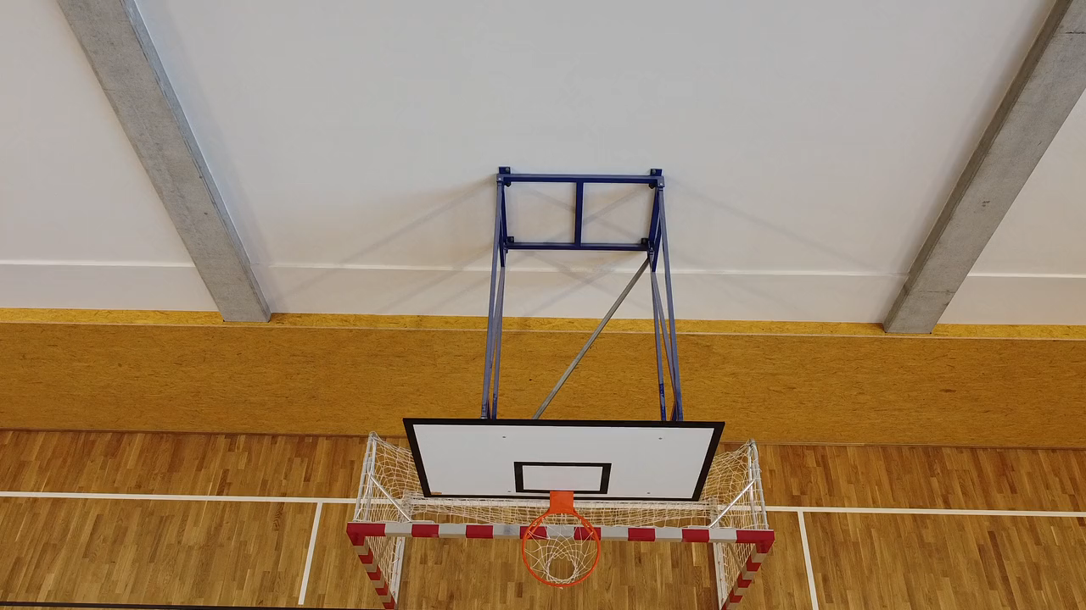
第一次籃球比賽
Notes:
https://pixabay.com/videos/school-gym-building-playground-43731/

Slide 2
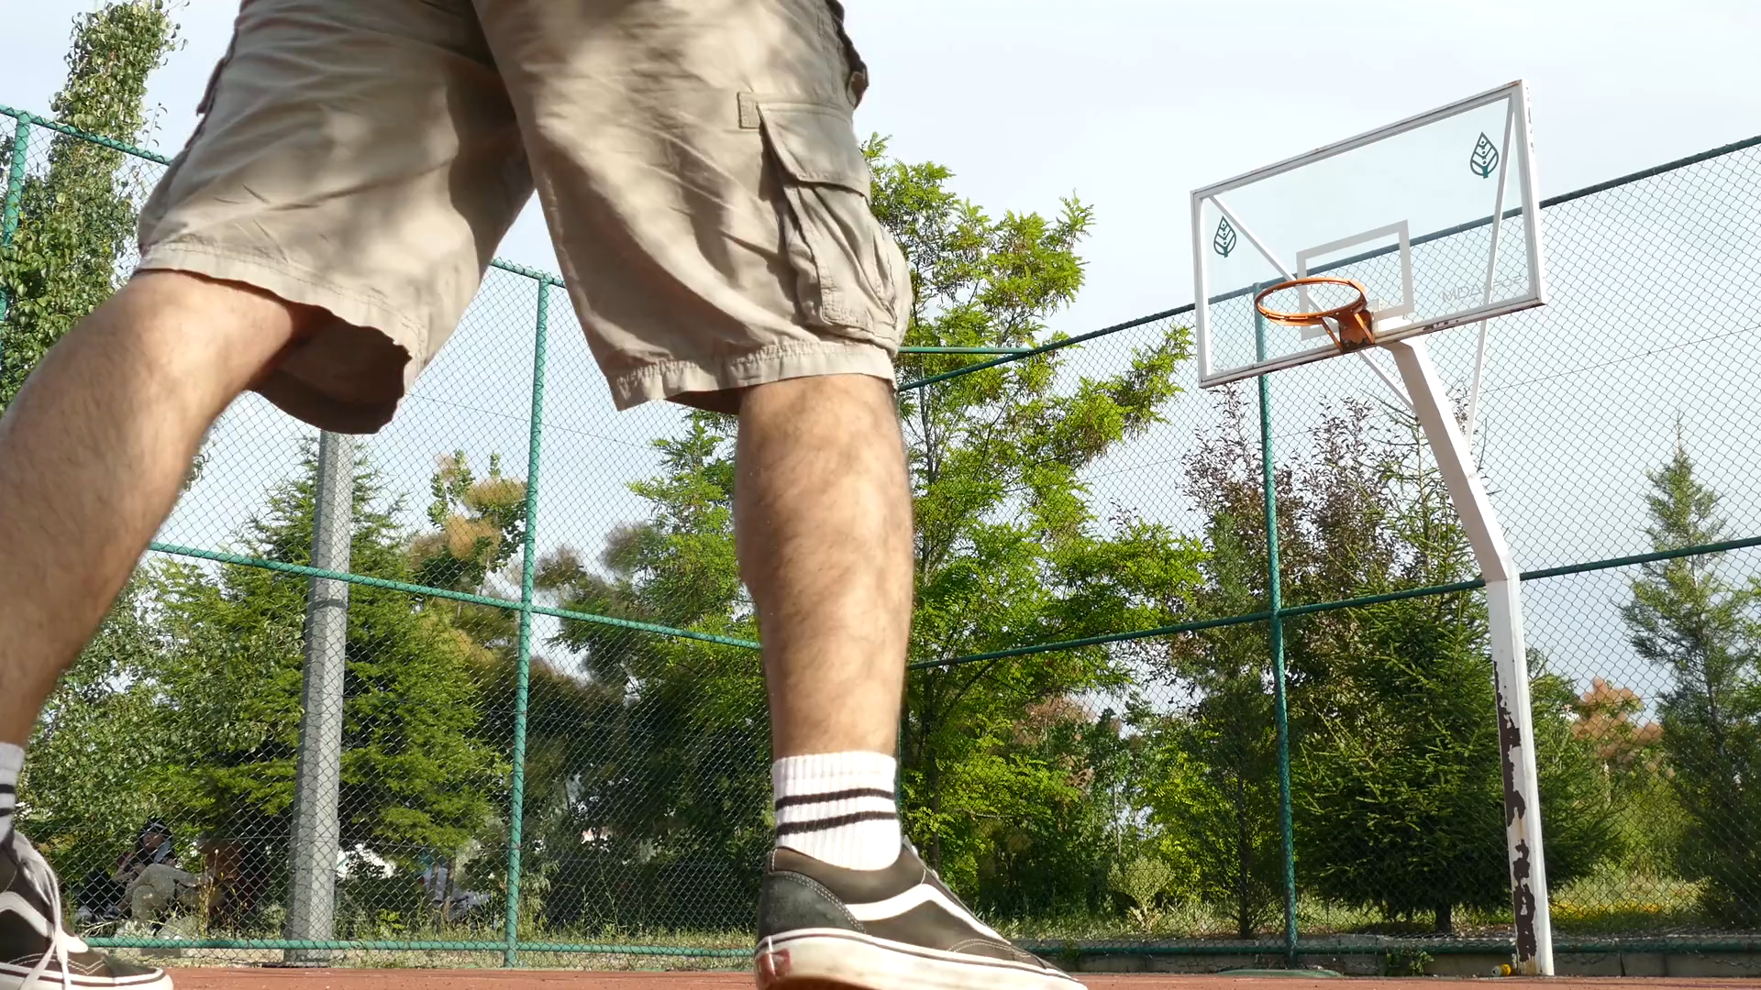
1. 目標
Notes:
https://pixabay.com/videos/basketball-sport-man-active-43594/

Slide 3

2.阻礙
Notes:
https://pixabay.com/videos/water-rafting-team-rapids-water-162255/

Slide 4
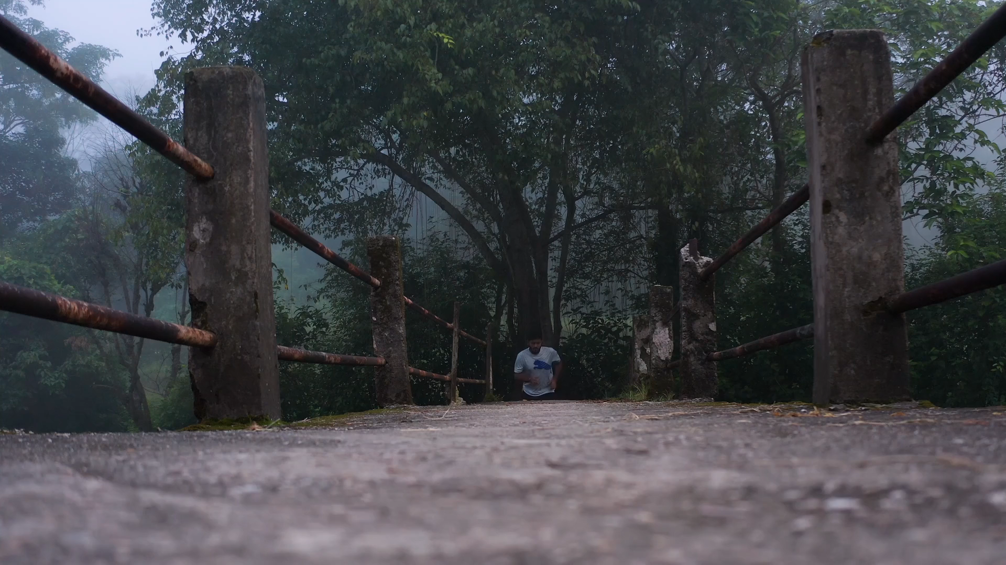
3. 努力
Notes:
https://pixabay.com/videos/running-bridge-mountains-27539/

Slide 5

4. 結果
Notes:
https://pixabay.com/videos/sea-ocean-seagulls-birds-sunset-140111/

Slide 6
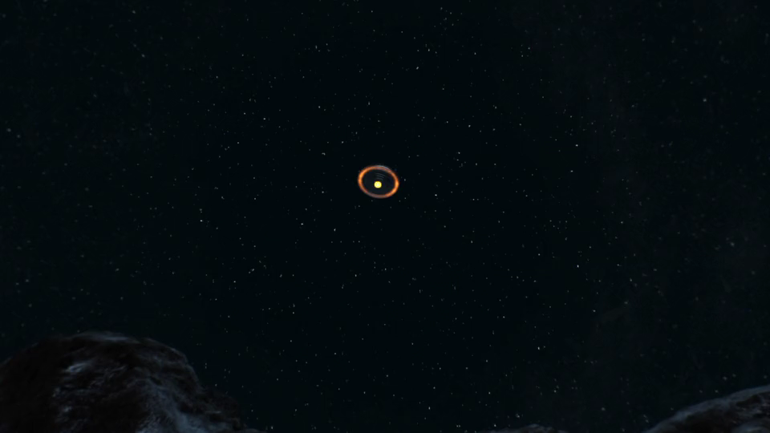
5. 意外
Notes:
https://pixabay.com/videos/aliens-ufo-explosion-crash-roswell-192777/

Slide 7
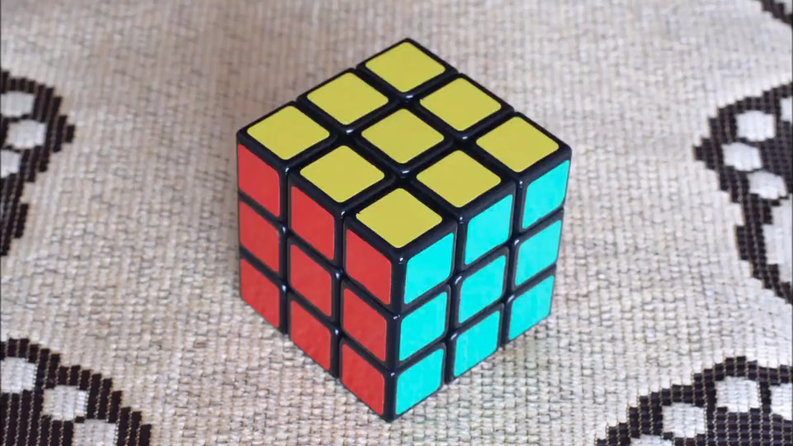
6. 轉彎
Notes:
https://pixabay.com/videos/rubiks-cube-cube-turn-animation-43679/

Slide 8

7. 結局
Notes:
https://pixabay.com/videos/basketball-shots-ball-game-hoop-8880/

